Slide 1
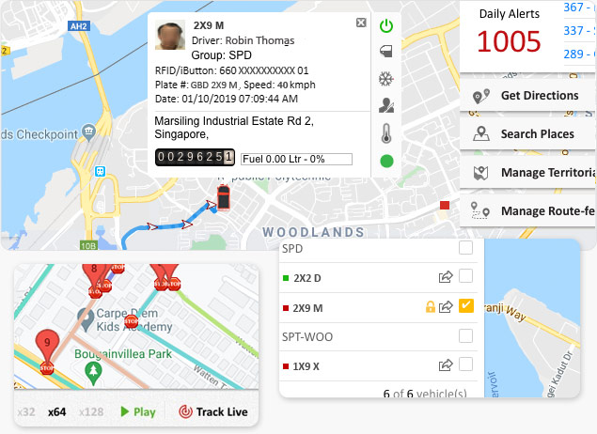

GPSTracker.in
GPSTracker.in
Vehicle & Asset Tracking Solutions

Slide 2
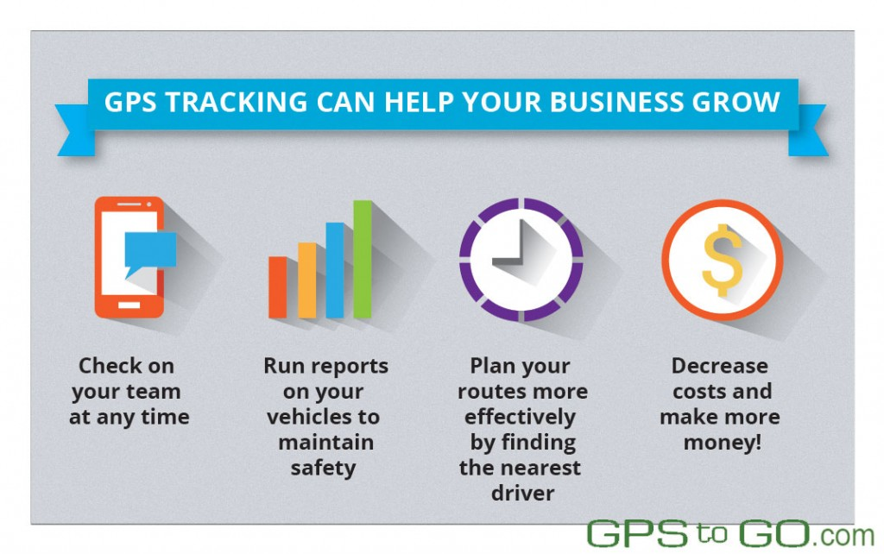



About Us
GPSTracker.in offers advanced GPS tracking solutions for vehicles, assets, and personnel. Our cutting-edge GPS tracking technology enables real-time tracking to enhance efficiency, security, and visibility across your fleet.
Satisfaction
Customer satisfaction, Team satisfaction
Excellence
Continuous expansion of productivity, Growth of service
Growth
Encompassing more and more companies in services

Slide 3


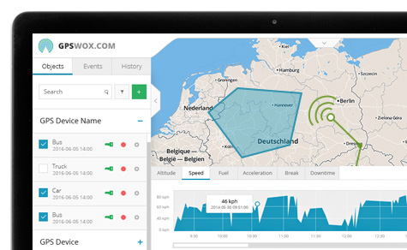






Key Features
Live Vehicle Tracking
Playback Path Facility
Monitor real-time location on intuitive dashboard
Review historical routes and analyze past movements
Advanced Reporting
Alert Generation
Generate comprehensive reports for fleet performance insights
Receive instant notifications for critical events
Stoppage & Vehicle Data
Fuel Monitoring
Access detailed information about vehicle stoppages
Track fuel consumption to identify inefficiencies
Geo-Fence Management
Driver Analysis
Evaluate driver performance and promote safe driving
Define virtual boundaries for automated monitoring

Slide 4



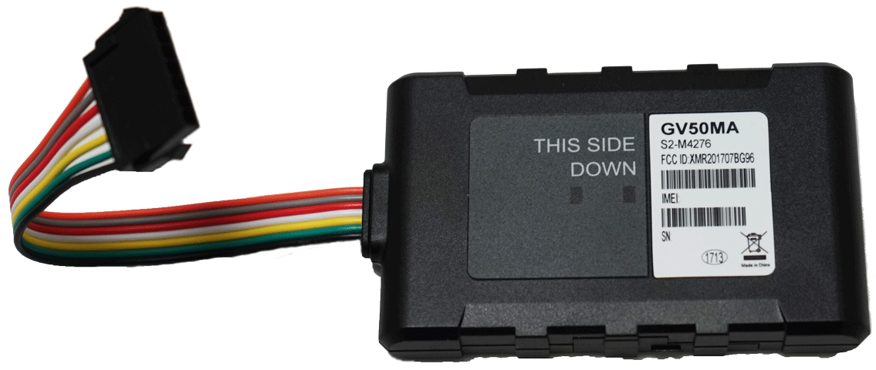




Hardware Components
Vehicle Trackers
Person Trackers
Ensure safety and efficiency of your vehicle fleet
Monitor location and safety of personnel in real-time
Asset Trackers
2G & 4G Compatible
Protect valuable assets by tracking their whereabouts
Support for various tracking requirements
OBD Devices
Waterproof Trackers
Plug-and-play solutions for easy installation
Durable solutions for harsh environments
Long Battery Life
Compact & Discreet
Extended operation without frequent charging
Covert tracking options when needed

Slide 5


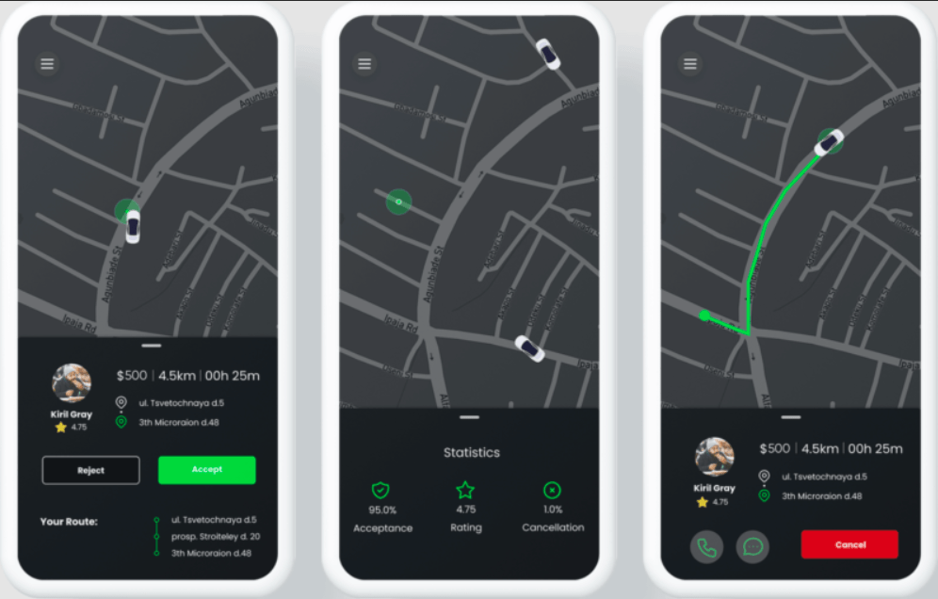





Software Capabilities
Real-Time Tracking
View Plot
Monitor exact location of vehicles on Google Map
Indicate path from start to end journey with flags
Device List Selection
Refresh Rate Selection
Show/hide devices on map
Control how often devices update on map
Map View Options
POI Management
Define and manage important geographic locations
Switch between normal and satellite views
Geo-Path Drawing
Multi-Vehicle Path
Plan, visualize, and store authorized travel paths
Display historical routes of multiple vehicles

Slide 6


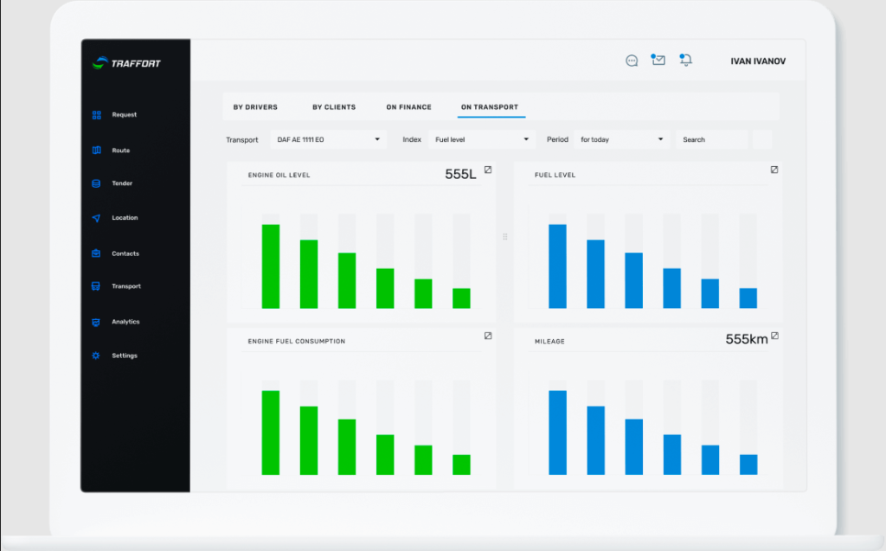




Reporting Features
Fleet Summary Report
GPS Vehicle History
Tabular record of vehicle's historical activity
Overview of vehicle activity over specified period
Speed Monitoring
POI History Report
Detailed activity and speed logs for analysis
Audit log of entries/exits at predefined locations
Stoppage Report
Trip Summary
Documents extended vehicle stoppages
High-level log of journeys with distance and time
Printable Summary
Excel Trip Report
Clean reports for formal use and record-keeping
Organized data for easy sorting and analysis

Slide 7


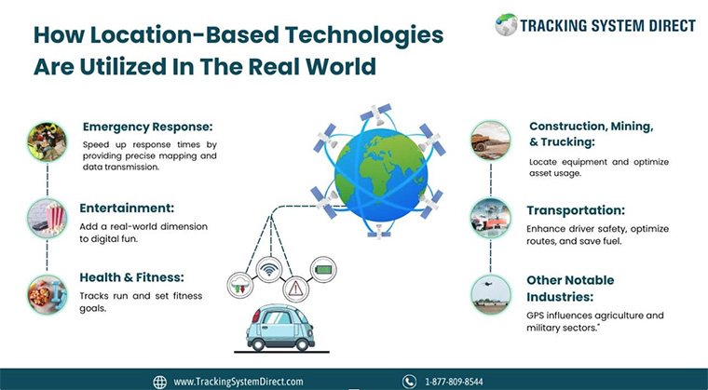




Industry Applications
Transporters
Mining Vehicles
Optimize fleet management and delivery routes
Monitor equipment and ensure safety in remote locations
Cabs & Ride-Sharing
School Buses
Provide accurate arrival times and ensure driver accountability
Guarantee student safety with real-time monitoring
Motorcycles & E-Bikes
Pharmaceuticals
Track and secure valuable vehicles
Ensure timely delivery and secure transportation of medical products

Slide 8

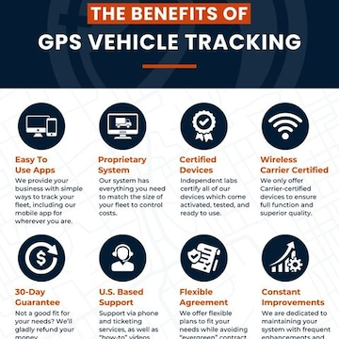



Benefits of GPS Tracking
Enhanced Security
Improved Efficiency
Real-time monitoring prevents theft and unauthorized use
Optimize routes and reduce fuel consumption
Increased Productivity
Better Customer Service
Monitor driver behavior and reduce idle time
Provide accurate ETAs and improve delivery reliability
Cost Reduction
Regulatory Compliance
Lower fuel costs, maintenance expenses, and insurance premiums
Ensure adherence to industry regulations and standards

Slide 9

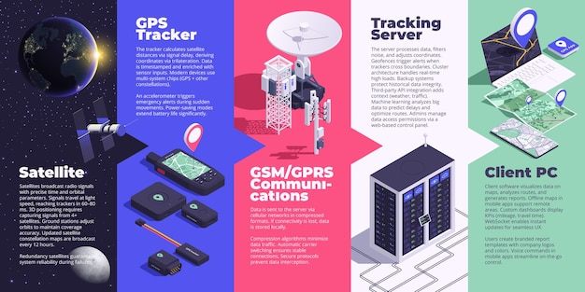



Contact Us
Landline (91) 79-26426364
Sales Contact +91 8154045500
Support Contact +91 8155045500
Email info@bonrix.net, gpsbonrix@gmail.com
Address Bonrix Software Systems, A-801, Samudra Complex, Near Classik Gold Hotel, Off C.G.Road, Ahmedabad, Gujarat - 380009, India
Thank You!

